Slide 1
PROBLEM STATEMENT- 5 TRAVEL PLANNER AGENT
INTERNSHIP FINAL PROJECT
Presented By:
Student name : MANAV SHAILESH PATEL
College Name & Department :
ICT GANPAT UNIVERSITY,AHEMDABAD
CSE(CYBERSECURITY)

Slide 2

OUTLINE
Problem Statement
Technology used
Wow factor
End users
Result
Conclusion
Future scope
IBM Certifications
Git-hub Link

Slide 3

Problem Statement
Travelers often struggle to find the best travel plan that fits their available days and budget. They also frequently lack sufficient knowledge about the destination and also for booking
Proposed Solution: An AI research agent that uses Natural Language Processing (NLP) and various tools to retrieve data from websites—such as weather information, destination details, travel costs, and available activities—based on the user's budget

Slide 4

Technology used
1. IBM cloud services (Main Component)
2. WATSON AI
3. NLP (Natural Language Processing)
4. IBM GRANITE MODEL
5

Slide 5

IBM cloud services used
1. IBM Cloud Watsonx AI Studio
2. IBM Cloud Watsonx AI runtime
3. IBM Cloud Agent Lab
4. IBM Granite foundation model (granite -3-3-8b-instruct)
5. Model parameter(like topk,temperature)
6 .Tools(to retrieve data from different websites and data of real time weather)

Slide 6

Wow factors
✈️ End-to-End Travel Planning Unlike regular apps, this agent handles everything from suggestions to simulated flight and hotel bookings, making it a one-stop solution.
📍 Personalized & Dynamic Itineraries Creates day-wise travel plans based on user preferences (budget, interests, group size, etc.), adapting automatically if plans change.
🌦️ Real-time Context Awareness Integrates weather updates, local events, and guides, helping users avoid bad weather or crowded areas and explore hidden gems.
🔁 Conversational Re-planning User changes their mind? No problem. The agent adapts plans on the fly, providing dynamic, voice/chat-based re-planning.
🚨 Smart Alerts & Schedule Optimization Alerts users about flight delays, budget overshoot, or bad weather, and suggests alternate options automatically.
🧩 Scalable for Future APIs Designed in a way that you can plug in real-world APIs later (Skyscanner, Booking.com, Google Maps) without breaking the architecture.
⚙️ Runs Fully on IBM Cloud Cost-effective and deployable on free-tier IBM infrastructure — great for students, scalable for enterprises.

Slide 7


End users
1) Individual Travelers
Solo adventurers, backpackers, or digital nomads who want personalized and quick travel plans.
2) Families and Groups
Families or friends planning group vacations who need budget-friendly and coordinated itineraries.
3) Business Travelers
Professionals needing efficient travel with optimized schedules and minimal delays.
4) Travel Agencies
Agencies can use the AI agent as a virtual assistant to automate customer support and pre-trip planning.
5) Students Planning Study Tours
Academic institutions or student groups organizing field trips or educational travel.
6) Frequent Flyers
People who travel often and want faster, smarter planning without repeating the same manual process.
7) Tour Operators & Event Planners
For managing destination events, corporate retreats, or packaged tours with dynamic customization.

Slide 8
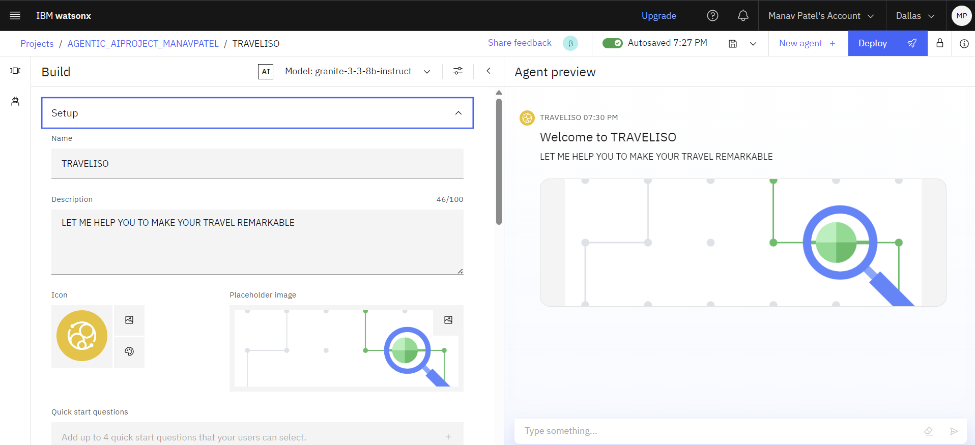
RESULTS(PART 1) -INTRO TO MY THE AGENT
I HAVE GIVEN A NAME TO MY AGENT WHICH IS TRAVELISO WHICH MAKES IT FEEL MORE REAL AND ANIMATED

Slide 9
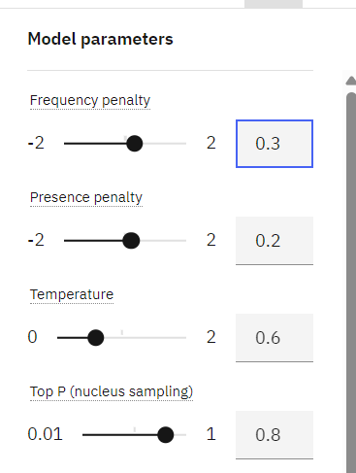
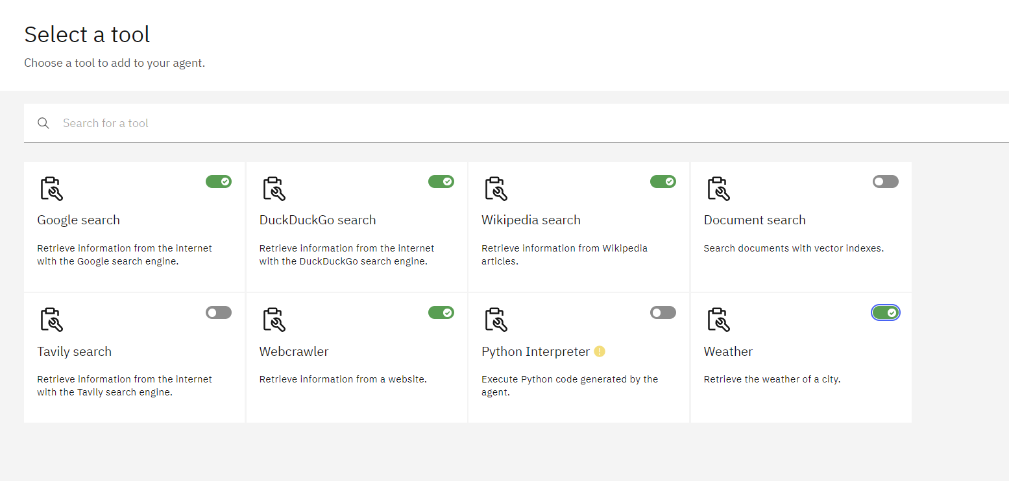
Results (PART-2)-THE TOOLS AND MODEL PARAMETERS
☝️ HERE ARE THE TOOLS USED IN MY PROJECT ☝️
☝️HERE IS THE VALUES OF MODEL PARAMETERS ☝️

Slide 10
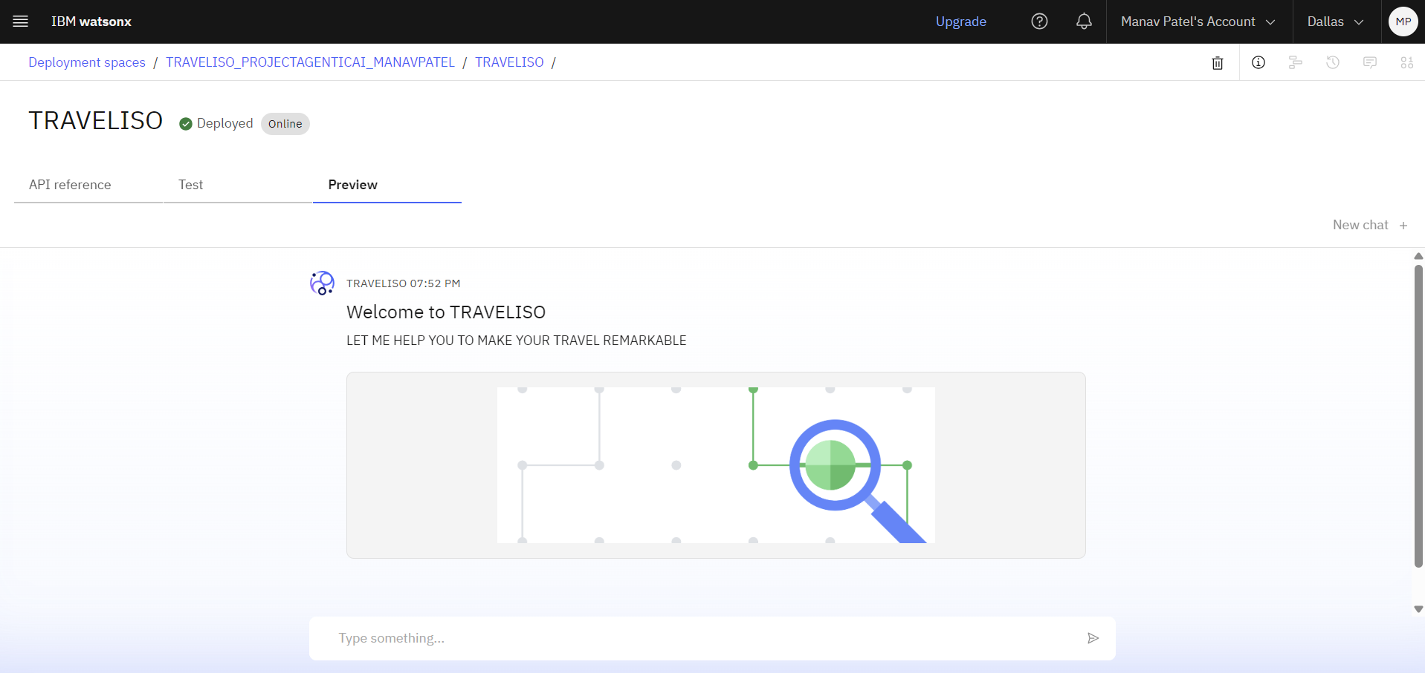
Results(PART 3)-DEPLOYED MY AGENTIC AI PROJECT
HERE WE CAN SEE THAT MY AGENT(TRAVELISO) IS DEPLOYED

Slide 11
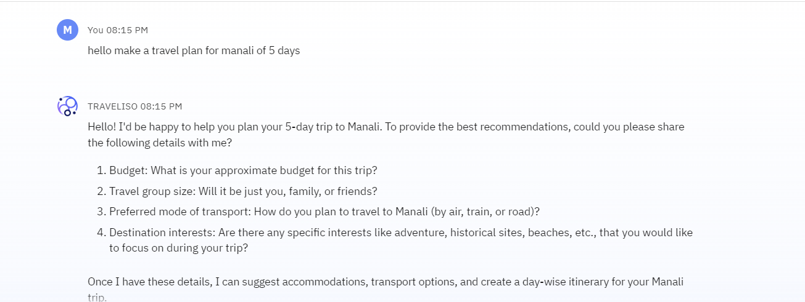

Results PART 4-TESTING
FOR TESTING -- I HAVE SAID TO CREATE A TRAVEL PLAN FOR MANALI OF 5 DAYS

Slide 12
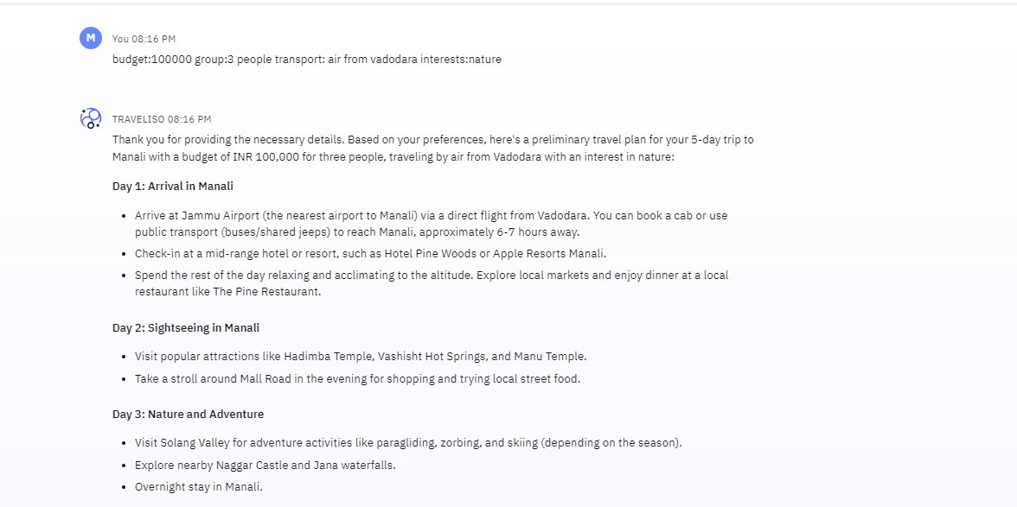

TESTING CONTINUE
THEN I HAVE ENTERED THE REQUIRED DETAILS WHICH WAS ASKED BY TRAVELISO TO CREATE THE PLAN

Slide 13
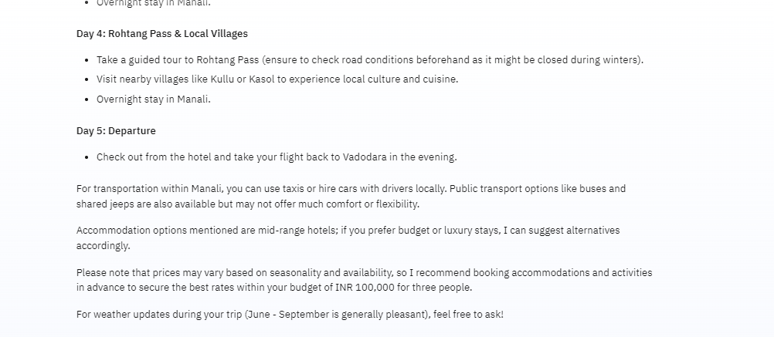

TESTING CONTINUE
HERE WE CAN SEE THAT I HAVE GOT A COMPLETE 5 DAYS TRAVEL PLAN FOR MANALI

Slide 14
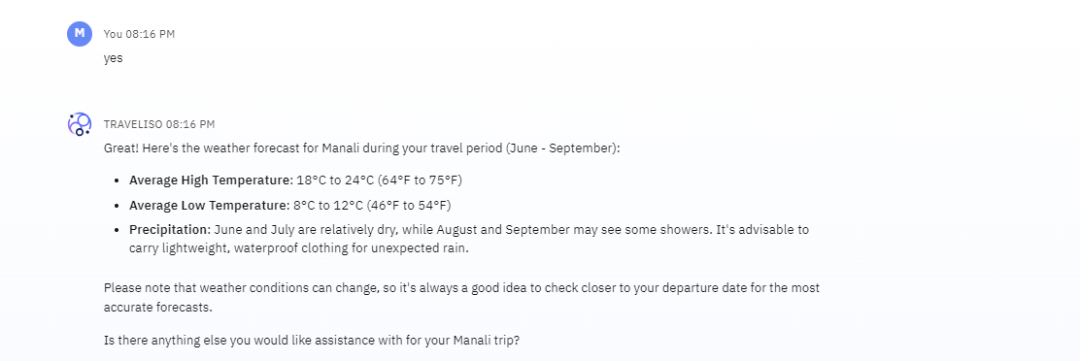

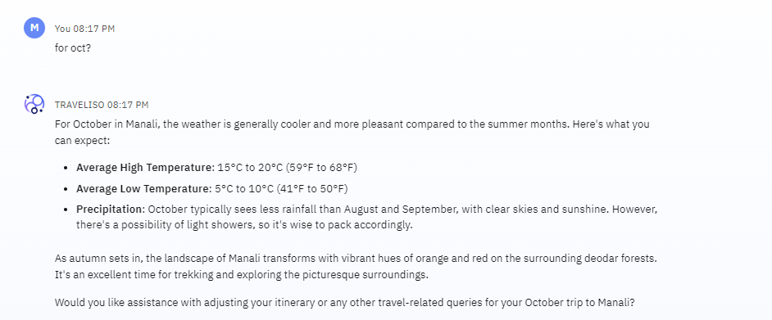
TESTING CONTINUE-REAL TIME WEATHER UPDATES
IN THE PREVIOUS SLIDE IT WAS ASKING ME TO PROVIDE THE REAL TIME WEATHER UPDATES(IF REQUIRED) SO I SAID YES AND HERE WE CAN SEE THE WEATHER UPDATES
HERE TO MAKE IT MORE DYNAMIC I HAVE ASKED THE WEATHER UPDATES OF OCT(AS I AM TRAVELLING IN THAT MONTH) SO WE CAN SEE THE WEATHER UPDATES OF OCTOBER TOO

Slide 15
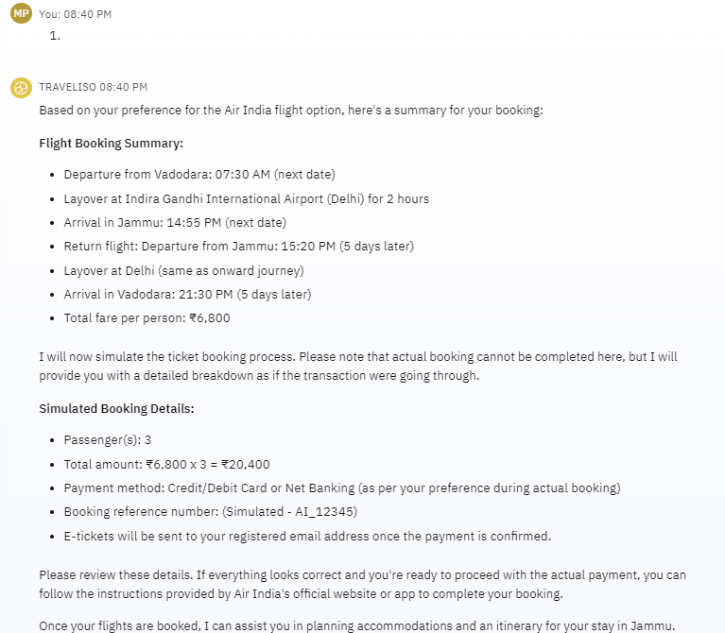

RESULTS PART-5 (FEATURE OF FLIGHT BOOKING)
Additionally, I have added a flight booking feature. It searches for the best flight options from the source to the destination, and then asks the user to review and proceed with the booking

Slide 16
Conclusion
1). 🔍 Simplifies Complex Travel Planning The agent streamlines destination selection, flight/hotel booking, and itinerary creation into one intelligent system.
2). 🧠 Delivers Personalized User Experience By understanding user preferences, it offers tailored suggestions, real-time adjustments, and contextual alerts.
3). 🤖 Harnesses Agentic AI with IBM Granite Utilizes powerful language models on IBM Cloud to enable natural, human-like conversations and reasoning.
4). ✈️ Simulates End-to-End Trip Management From flight booking to weather updates and local guides, the agent covers the full travel journey lifecycle.

Slide 17
Future scope
1) 🌐 Integration with Real-Time APIs Connect with real-world services like Skyscanner, Booking.com, Google Maps, and The Weather Channel for live bookings and updates.
2) 🎙️ Voice Assistant Integration Enable voice-based interaction using IBM Watson Speech-to-Text and Text-to-Speech, making it hands-free and more accessible.
3) 💳 Payment Gateway Support Add secure payment integration for real-time flight and hotel bookings within the agent interface.
4) 📱 Mobile App Deployment Develop a mobile-first version of the planner for Android/iOS, enhancing accessibility and on-the-go usage.
5) 🧳 AI-Powered Travel Expense Tracker Include post-trip features like expense summaries, travel history, and personalized recommendations for future trips.
6) 🔐 User Login & Trip History Store user profiles and past itineraries for repeat planning, with login/authentication functionality.

Slide 18
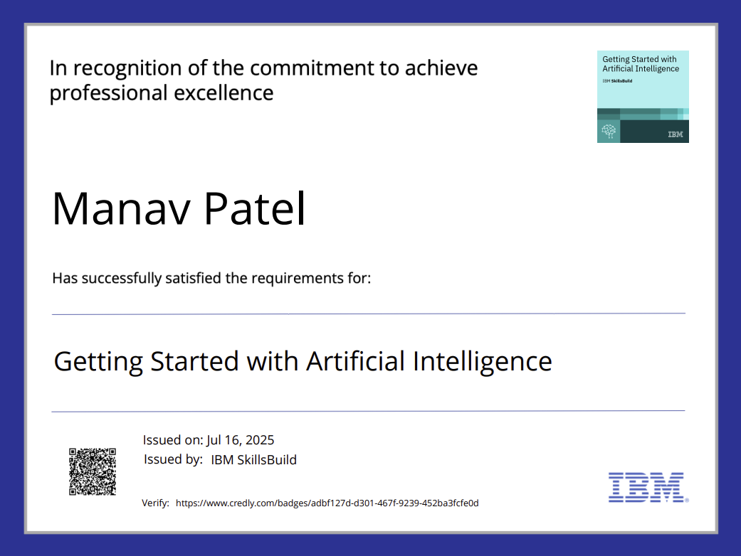
IBM Certifications-GETTING Started with ai

Slide 19
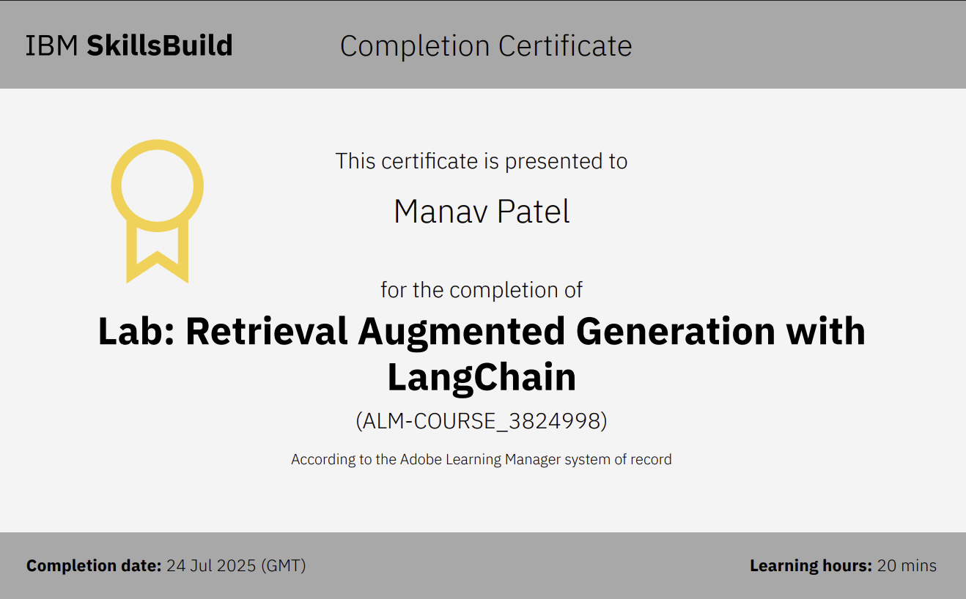
IBM CERTIFICATIONS-RAG LAB

Slide 20
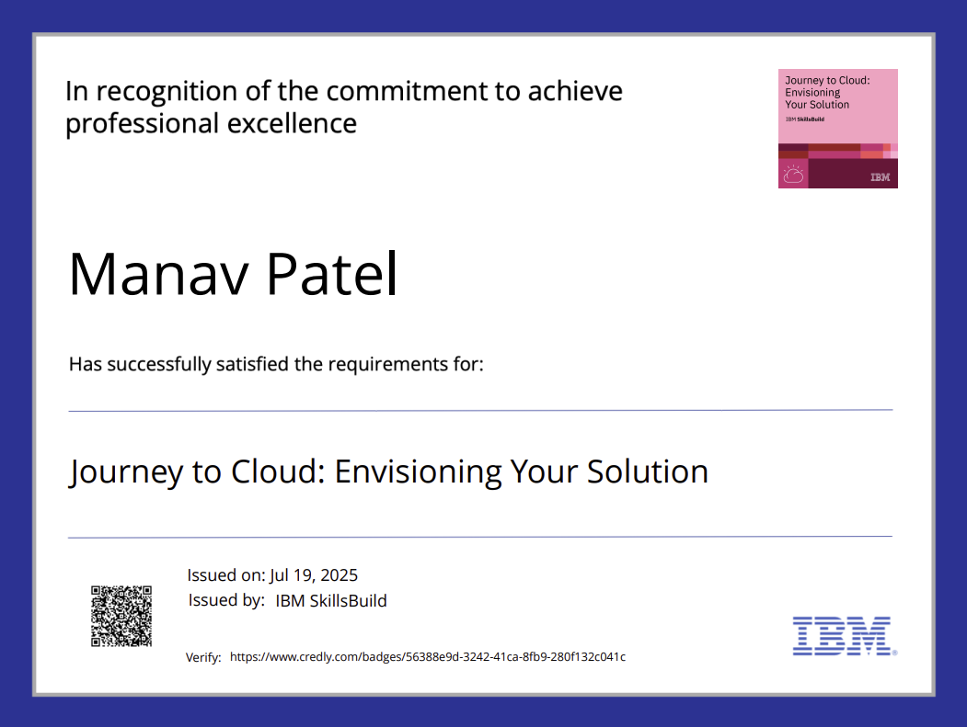
IBM CERTIFICATIONS-JOURNEY TO CLOUD

Slide 21

GitHub Link
👇GITHUB LINK👇
https://github.com/Manav9825/INTERNSHIP_PROJECT_MANAVPATEL_AGENTICAI.git

Slide 22
😊THANK YOUUU😊
SUBMITTED BY:
MANAV SHAILESH PATEL
manav7785@gmail.com

